Slide 1
Tıtanıc dataset classıfıcatıon analysıs
Arda Nalbant
Niyazi Ozan Ateş
Umut Bayar

Slide 2
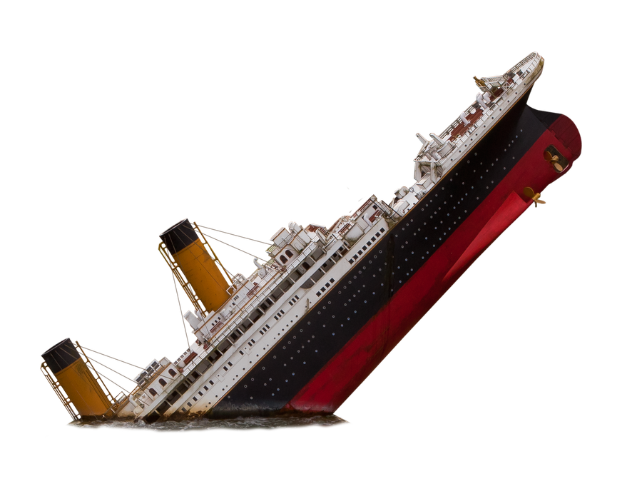
PROBLEM DEFINITON
The Titanic dataset is a classic machine learning problem that involves predicting the survival of passengers aboard the RMS Titanic, which tragically sank in 1912. This problem is a binary classification task, where the goal is to determine whether a passenger survived or not based on various features.

Slide 3
Dataset InformatIon
Dataset: Titanic Dataset
- Number of instances: 1 MILLION
- Features: Name, Age, Gender, Class, Survived, etc.
- Target variable: Survived (0 or 1)
- PassengerID, Ticket and Cabin columns dropped

Slide 4
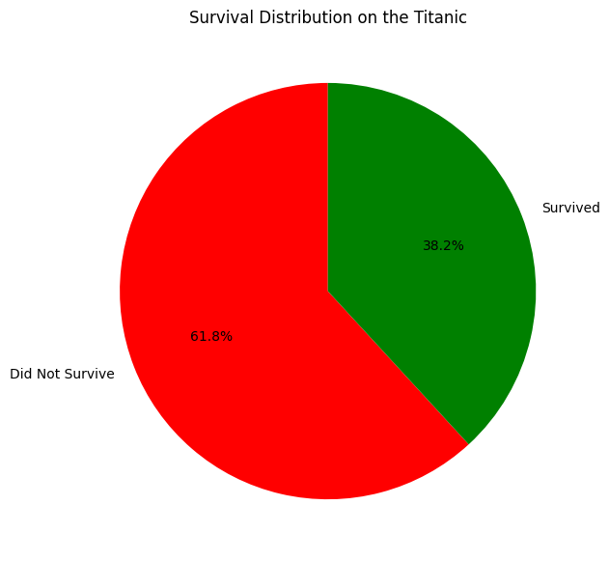
Survıved
-Indicates whether the passenger survived (1) or did not survive (0). This is a binary outcome used in survival analysis.

Slide 5
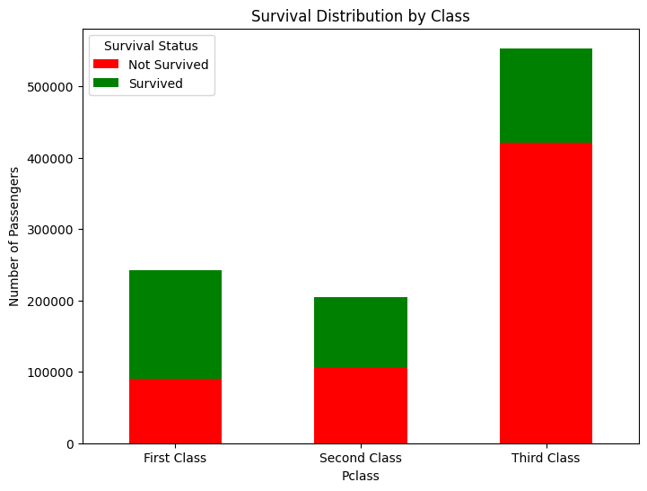
PCLASS
The passenger's class on the Titanic. It is an integer value:
1: First class
2: Second class
3: Third class

Slide 6
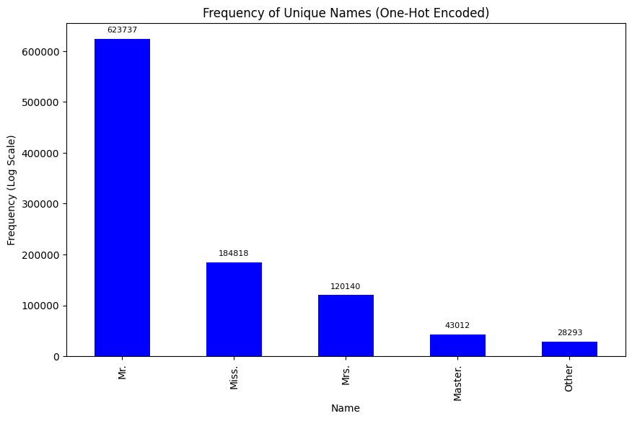
Name
The "Name" column was originally formatted as "NameXXXX, Prefix. SurnameXXXX". We simplified it to include only the prefix and grouped the data by the most frequently used four prefixes, categorizing all others under "Others".

Slide 7
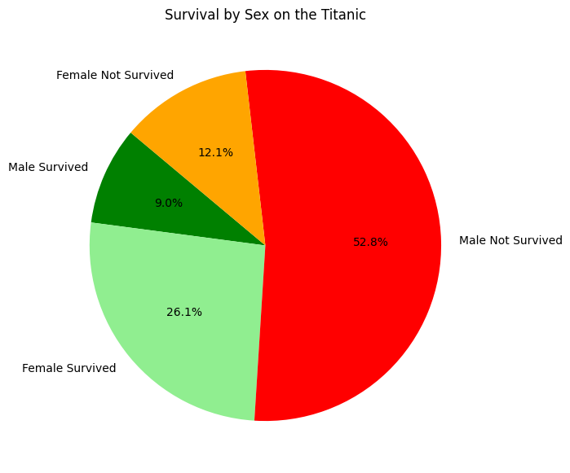
SEX
The gender of the passenger. Values are "male" or "female" turned to 0, 1.

Slide 8
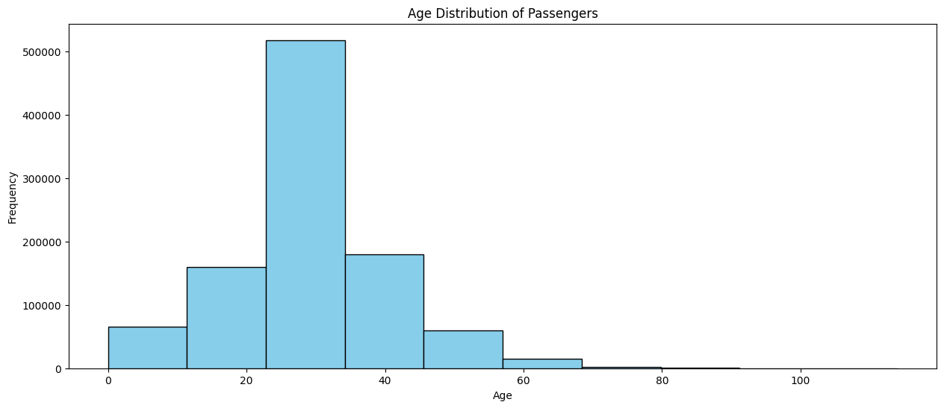
AGE
The age of the passenger. As some entries were missing, the missing values were filled in with the calculated mean.

Slide 9
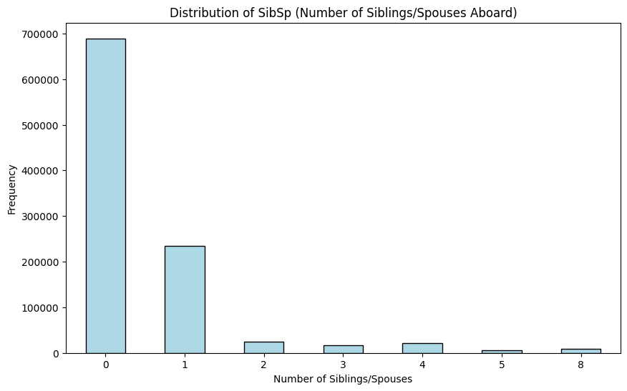
SIBSP
The number of siblings or spouses the passenger had aboard the Titanic.

Slide 10
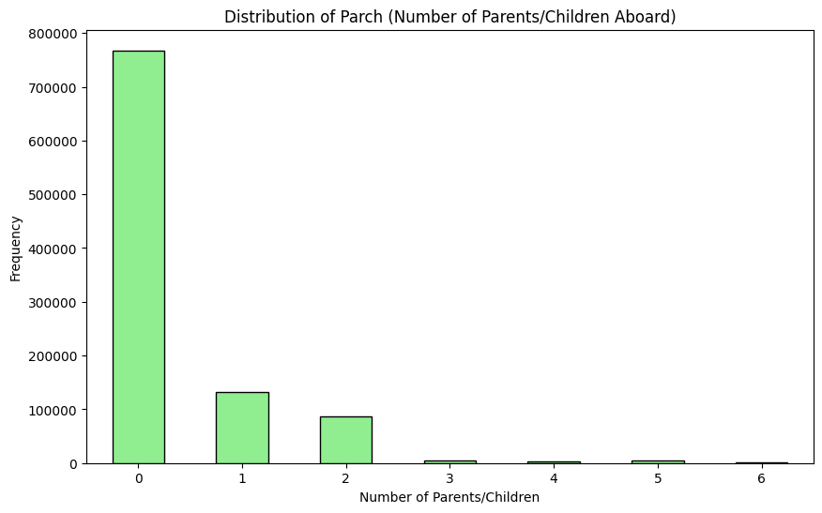
PARCH
The number of parents or children the passenger had aboard the Titanic.

Slide 11
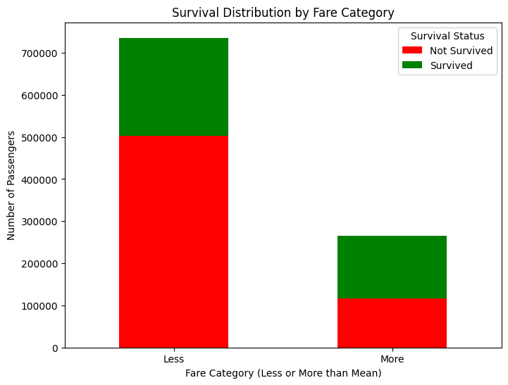
Fare
The fare that the passenger paid for the ticket.

Slide 12
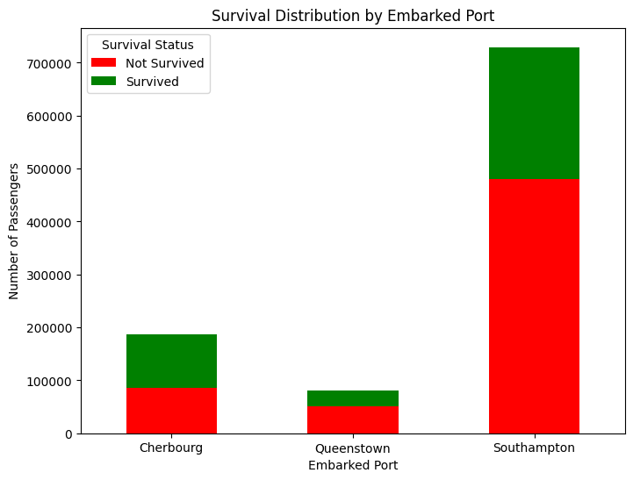
EMBARKED
The port where the passenger boarded the Titanic. The categorical values turned to binary using one-hot encoding: "C": Cherbourg "Q": Queenstown "S": Southampton

Slide 13
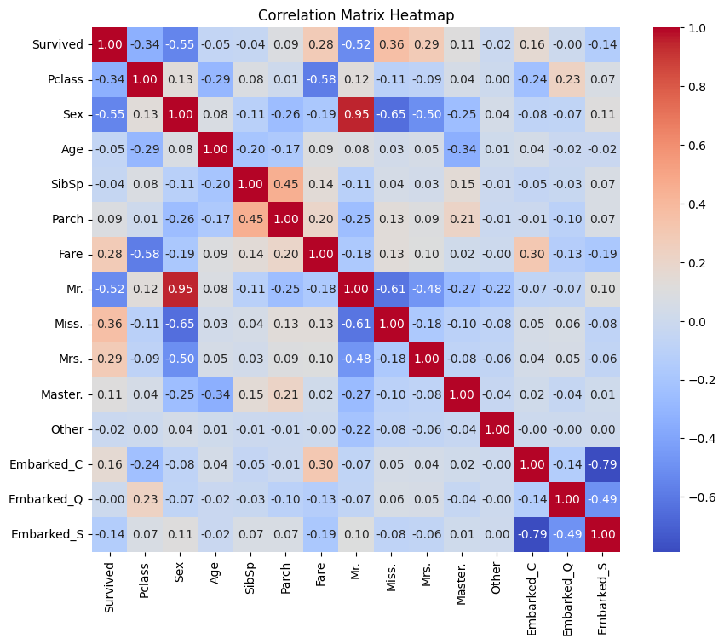
Correlatıon matrıx
A correlation matrix is a table that shows the correlation coefficients between multiple variables. Each cell in the matrix represents the correlation between two variables, ranging from -1 to 1:
+1 indicates a perfect positive correlation (both variables increase together).
-1 indicates a perfect negative correlation (one variable increases while the other decreases).
0 indicates no linear relationship between the variables.

Slide 14
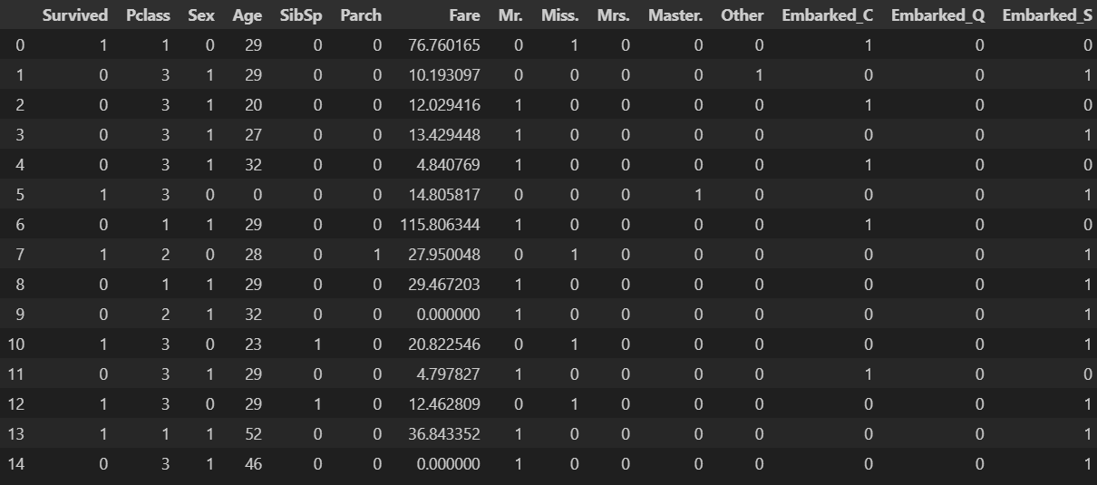
Partition of the Data
800.000 train instance ------------------------------- 200.000 test instance

Slide 15
Implementatıon detaıls
- Python 3.11.6
- Jupyter Notebook v6.5.1
- VS Code v1.96.2

Slide 16
LIBRARIES
pandas: Data manipulation and analysis with DataFrames.
numpy: Numerical operations and array handling.
matplotlib.pyplot: Plotting library for creating visualizations.
seaborn: Statistical data visualization based on matplotlib.
re: Regular expressions for pattern matching and text manipulation.
Sklearn.datasets.loadiris: Loads the Iris dataset for machine learning tasks.
sklearn.preprocessing.Normalizer: Scales input data to unit norm for normalization. sklearn.model_selection: Tools for splitting data (train_test_split), cross-validation (cross_val_score, KFold).
sklearn.ensemble: Ensemble classifiers (AdaBoost, Bagging).

Slide 17
LIBRARIES
sklearn.svm.SVC: Support Vector Classifier.
sklearn.tree.DecisionTreeClassifier: Decision tree-based classifier.
sklearn.naive_bayes.GaussianNB: Naïve Bayes classifier for continuous data.
sklearn.neural_network.MLPClassifier: Multi-layer Perceptron (neural network) classifier.
sklearn.metrics
accuracy_score: Measures the accuracy of predictions.
classification_report: Detailed classification performance report.
confusion_matrix: Summarizes prediction errors.
f1_score: Harmonic mean of precision and recall.
precision_score: Proportion of correct positive predictions.
recall_score: Proportion of true positives correctly identified.

Slide 18
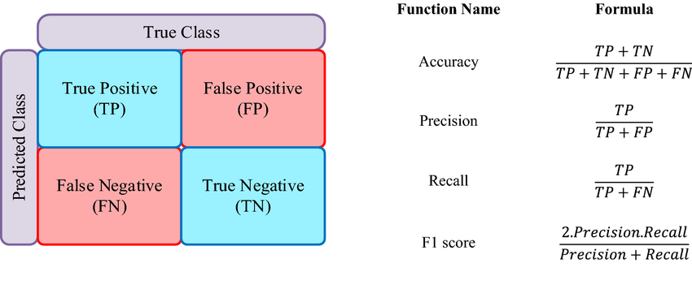
Confusıon matrıx and metrics

Slide 19
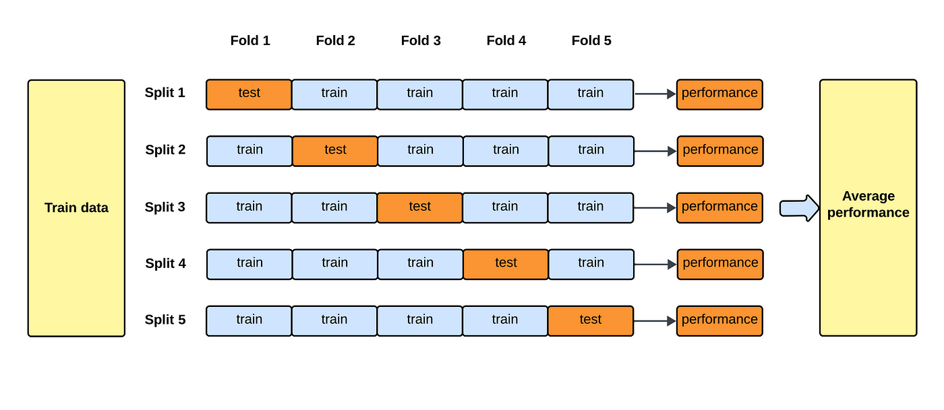
cross-validation
Cross-validation is a technique used to assess the performance of a machine learning model. It involves splitting the dataset into multiple subsets (folds), training the model on some folds, and testing it on the remaining fold. The most common method is k-fold cross-validation, where the data is divided into k (k=5) equal folds.

Slide 20
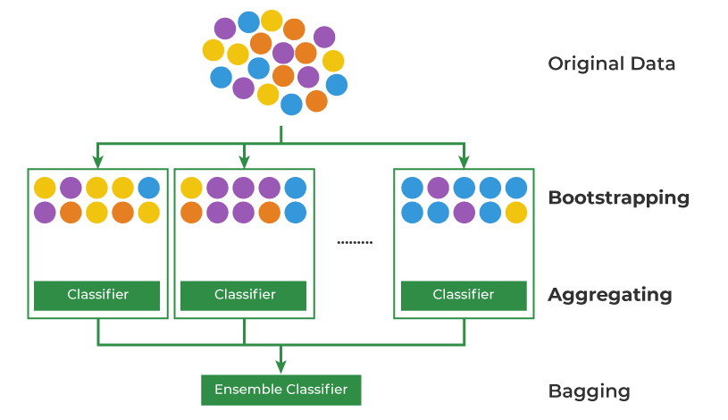
BAGGING
Bagging (Bootstrap Aggregating) is an ensemble learning technique that improves the accuracy and stability of machine learning models.
Bootstrap Sampling: Randomly sample with replacement from the training data to create multiple subsets.
Model Training: Train a separate model on each of these subsets.
Aggregation: For classification, the final prediction is made by taking a majority vote of the individual models.
We are bagging 50 times for naive bayes and 5 times for everything else.

Slide 21
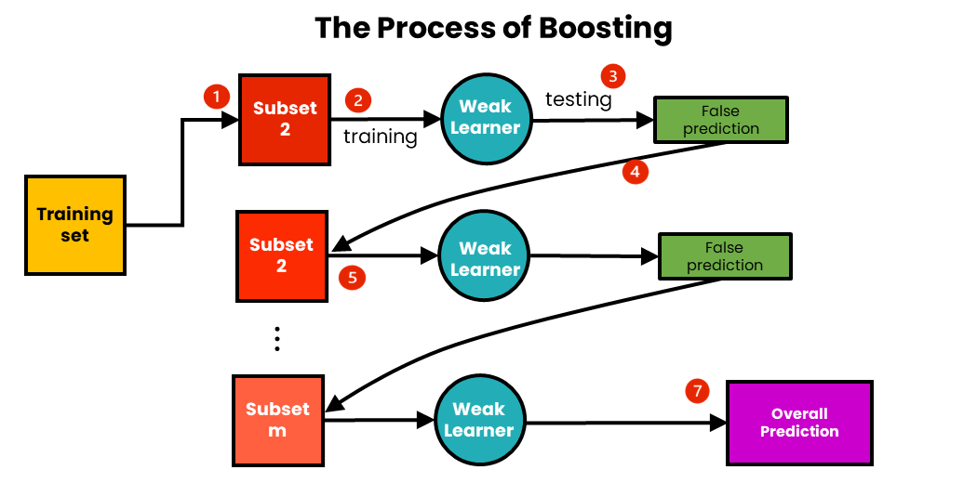
BOOSTING
Boosting is an ensemble technique that combines multiple weak learners (typically simple models like decision trees) to create a strong model.
The first model is trained on the data.
Subsequent models focus on the data points that previous models misclassified, giving them more weight.
The final prediction is a weighted combination of all models.
We are boosting 50 times for naive bayes and 5 times for everything else.

Slide 22
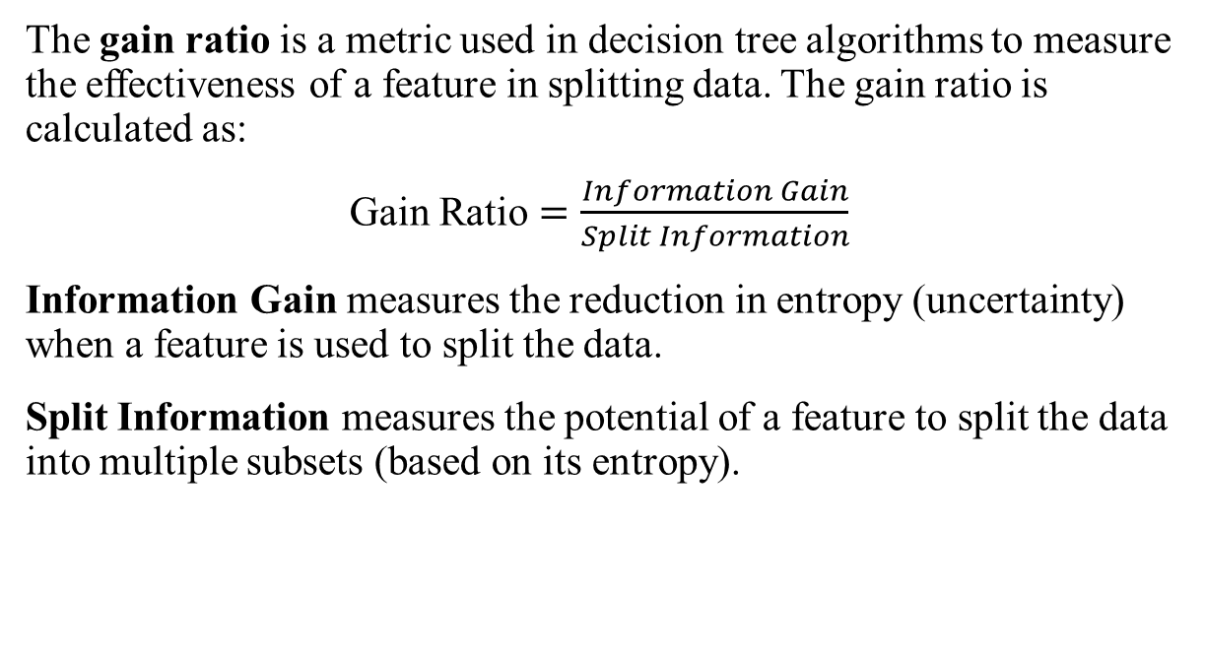
Gain ratio
The gain ratio is a metric used in decision tree algorithms to measure the effectiveness of a feature in splitting data. The gain ratio is calculated as:
Gain Ratio $=\frac{Information Gain}{Split Information}$
Information Gain measures the reduction in entropy (uncertainty) when a feature is used to split the data.
Split Information measures the potential of a feature to split the data into multiple subsets (based on its entropy).

Slide 23
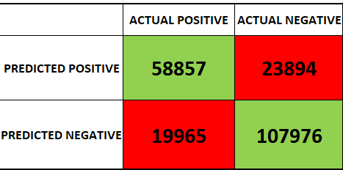
Gain ratio
Accuracy: 0.83416
Precision: 0.78761
Recall: 0.77287
F1 Score: 0.78017

Slide 24
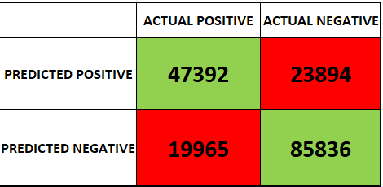

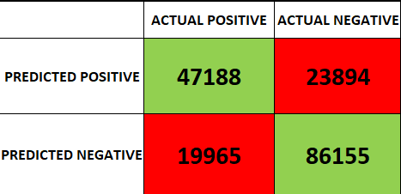
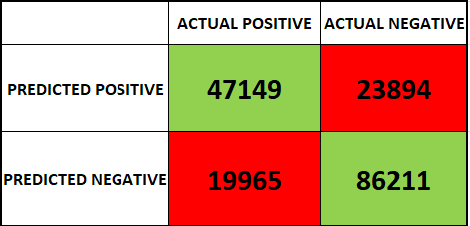

Gain ratio with cross-validation
Avg. Accuracy: 0.83318
Avg. Precision: 0.77971
Avg. Recall: 0.78649
Avg. F1 Score: 0.77306
Fold 1: Fold 2:
Fold 3:
Fold 4:
Fold 5:

Slide 25
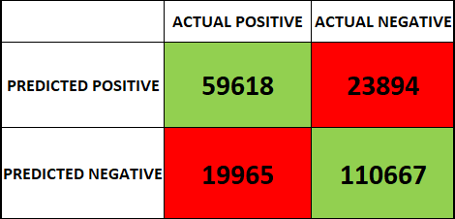
Gain ratio with BAGGING
Accuracy: 0.85142
Precision: 0.81895
Recall: 0.78287
F1 Score: 0.80050

Slide 26

Gain ratio with BOOSTING
Accuracy: 0.83442
Precision: 0.78640
Recall: 0.77589
F1 Score: 0.78111

Slide 27
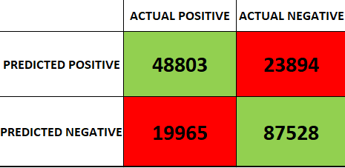
Gain ratio with cross-validation, bagging and boosting
There is not a lot of work about using kfold, bagging and boosting at the same time but out of curiosity: Average accuracy: 0.852074
Average F1 score: 0.80483
Average Precision: 0.811111
Average Recall: 0.79867

Slide 28
GAIN RATIO RESULTS
Base Gain Ratio
Accuracy:0.83416
With Cross Validation
Accuracy: 0.83318
With Bagging
Accuracy: 0.85142
With Boosting
Accuracy: 0.83442
With Cross Validation, Bagging and Boosting
Accuracy: 0.852074

Slide 29
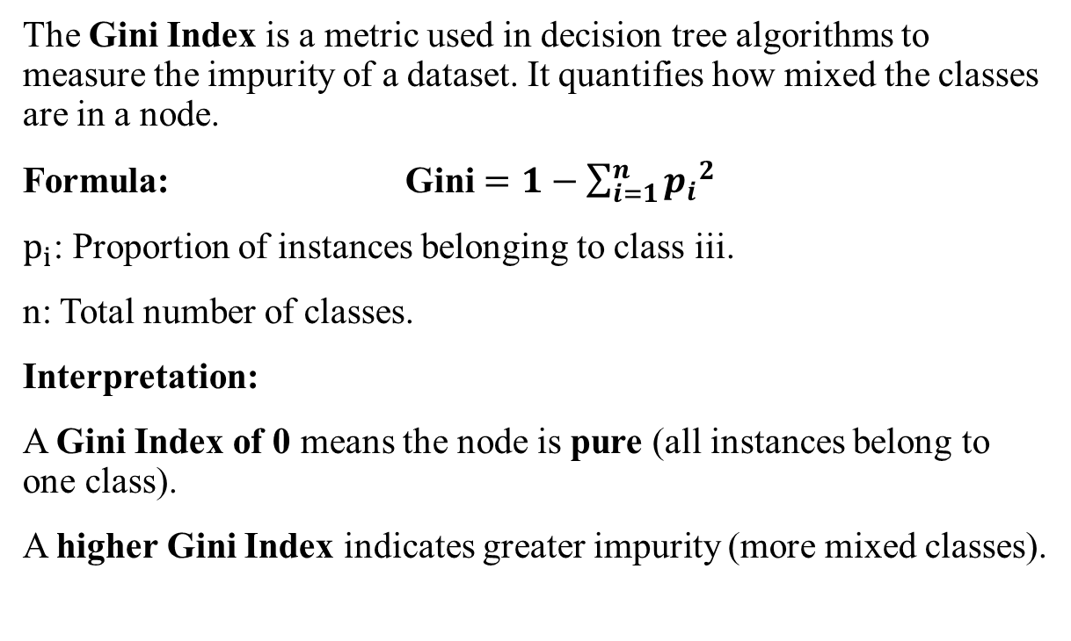
GINI INDEX
The Gini Index is a metric used in decision tree algorithms to measure the impurity of a dataset. It quantifies how mixed the classes are in a node.
Formula: Gini $=1−\sum_{i=1}^{n}{{p_{i}}^{2}}$
$p_{i}$: Proportion of instances belonging to class iii.
n: Total number of classes.
Interpretation:
A Gini Index of 0 means the node is pure (all instances belong to one class).
A higher Gini Index indicates greater impurity (more mixed classes).

Slide 30
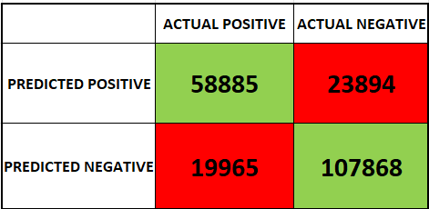
GINI INDEX
Accuracy: 0.83376
Precision: 0.78655
Recall: 0.77324
F1 Score: 0.77984

Slide 31

GINI INDEX WITH BAGGING
Accuracy: 0.85049
Precision: 0.81724
Recall: 0.78228
F1 Score: 0.79938

Slide 32

GINI INDEX WITH BOOSTING
Accuracy: 0.83481
Precision: 0.78654
Recall: 0.77704
F1 Score: 0.78176

Slide 33
GINI INDEX RESULTS
Base Gini index
Accuracy:0.83376
With Bagging
Accuracy: 0.85049
With Boosting
Accuracy: 0.83481

Slide 34
NAIVE Bayes
Process:
Calculate the prior probabilities for each class.
Calculate the likelihood for each feature given the class.
Multiply the priors and likelihoods to get the posterior probability for each class.
The class with the highest posterior probability is chosen.
Normalization in Naive Bayes is important because it ensures that features with different scales or units contribute equally to the likelihood calculation.

Slide 35
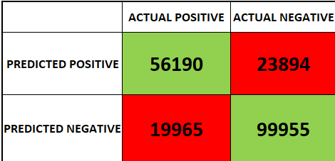
NAIVE Bayes
Accuracy: 0.78072
Precision: 0.70165
Recall: 0.73785
F1 Score: 0.71930

Slide 36

NAIVE Bayes wıth baggıng
Accuracy: 0.78070
Precision: 0.70163
Recall: 0.73783
F1 Score: 0.71927

Slide 37
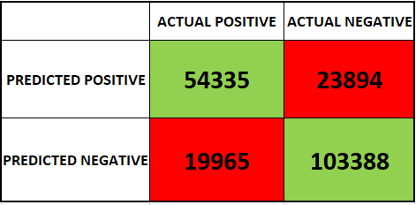
NAIVE Bayes wıth boostıng
Accuracy: 0.78786
Precision: 0.72600
Recall: 0.71131
F1 Score: 0.71858

Slide 38
NAIVE Bayes Results
Base Naive Bayes
Accuracy:0.78072
With Bagging
Accuracy: 0.78070
With Boosting
Accuracy: 0.78786

Slide 39
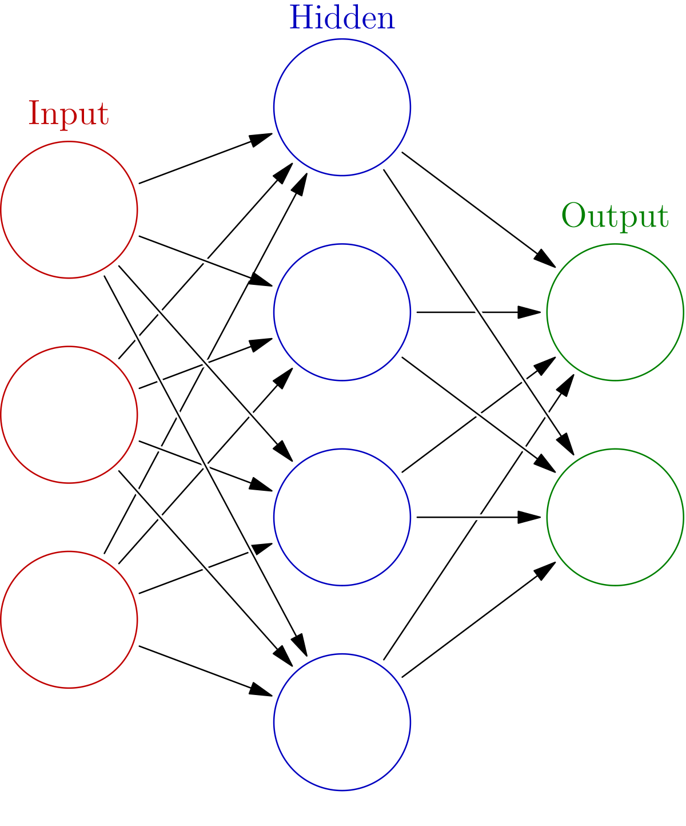
ArtIfIcIal neural networks
Artificial neural network (ANN) model involves computations and mathematics, which simulate the human–brain processes.
The ANN models have the specific architecture format, which is inspired by a biological nervous system.
Like the structure of the human brain, the ANN models consist of neurons in a complex and nonlinear form. The neurons are connected to each other by weighted links.

Slide 40
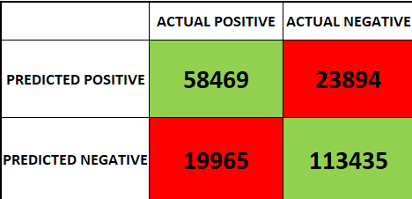
ArtIfIcIal neural networks
Accuracy: 0.85952
Precision: 0.85892
Recall: 0.85952
F1 Score: 0.85800

Slide 41

ANN WITH BAGGING
Accuracy: 0.85865
Precision: 0.86019
Recall: 0.85865
F1 Score: 0.85575

Slide 42
ANN RESULTS
Base 1-Layer ANN
Accuracy:0.85952
With Bagging
Accuracy: 0.85865

Slide 43
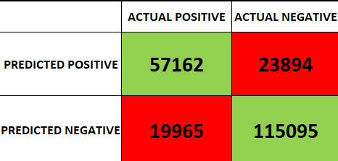
2 hidden layers ANN
Accuracy: 0.86128
Precision: 0.86173
Recall: 0.86128
F1 Score: 0.85903

Slide 44
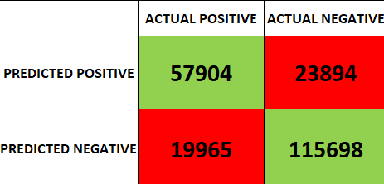
2 hidden layers ANN WITH BAGGING
Accuracy: 0.85865
Precision: 0.86019
Recall: 0.85865
F1 Score: 0.85575

Slide 45
2 hidden layers ANN RESULTS
Base 2-Layer ANN
Accuracy: 0.85002
With Bagging
Accuracy: 0.85865

Slide 46

Support vector machines
SVM is a powerful machine learning algorithm widely used for both linear and nonlinear classification, as well as regression and outlier detection tasks.
SVM works by mapping data to a high-dimensional feature space so that data points can be categorized, even when the data are not otherwise linearly separable. A separator between the categories is found, then the data are transformed in such a way that the separator could be drawn as a hyperplane.

Slide 47

Support vector machines
Accuracy: 0.85002
Precision: 0.88439
Recall: 0.69726
F1 Score: 0.77976

Slide 48

Support vector machines WITH BAGGING
Accuracy: 0.85008
Precision: 0.88655
Recall: 0.69523
F1 Score: 0.77932

Slide 49
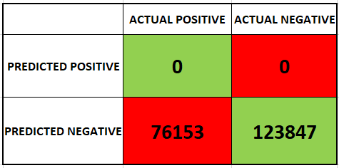
Support vector machines WITH BOOSTING
Accuracy: 0.61923
Precision: 0.0
Recall: 0.0
F1 Score: 0.0
WHAT HAPPENED?
The SVM, combined with boosting, may be overly biased toward the majority class, effectively ignoring the minority (positive) class.
Boosting works by iteratively focusing on misclassified instances, but SVMs are inherently margin-based classifiers. This can lead to suboptimal performance if the two techniques are not well-tuned together.

Slide 50

Support vector machines RESULTS
Base SVM
Accuracy: 0.85002
With Bagging
Accuracy: 0.85008
With Boosting
Accuracy: 0.61923

Slide 51
RESULTS FOR ALL
Best results from all classifiers:
Gain Ratio: ANN with 1 hidden layer:
With Bagging Base 1-Layer ANN
Accuracy: 0.85142 Accuracy:0.85952
Gini index: ANN with 2 hidden layer:
With Bagging With Bagging
Accuracy: 0.85049 Accuracy: 0.85865
Naive Bayes: Support vector machine:
With Boosting With Bagging
Accuracy: 0.78786 Accuracy: 0.85008

Slide 52

RESULTS FOR ALL
On Kaggle, a user known as 'Competition Notebook' achieved a remarkable 88% accuracy using LightGBM as the classifier for this dataset. Our result, using a single hidden layer artificial neural network (ANN), reached an accuracy of 85.952%. While our performance falls slightly short, it’s worth noting that LightGBM wasn’t included in the scope of our study. Aside from LightGBM, the second-best result on the leaderboard was achieved with XGBoost (XGBClassifier), which had an accuracy of 85.31%. This comparison highlights that our ANN approach performed competitively and delivered a strong result.

Slide 53
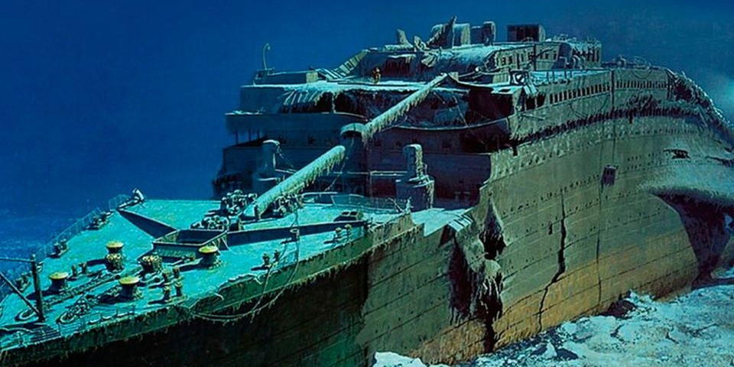
THANKS FOR LISTENING

